Slide 1
BECOME A SECURITY NINJA
Don’t let your code be low-hanging fruit
Paul Gilzow gilzow@missouri.edu Twitter: @gilzow Facebook: /gilzow https://www.linkedin.com/in/gilzow
Notes:
I need to mention Defense-in-Depth at some point, but where? Should we discuss least-privilege?
Should I add an Impact section for each piece?

Slide 2
What we will talk about
Get our example files up and running
What is OWASP
What is the OWASP Top 10
The Current Top 10 Web Security Risks
ATTACK!

Slide 3
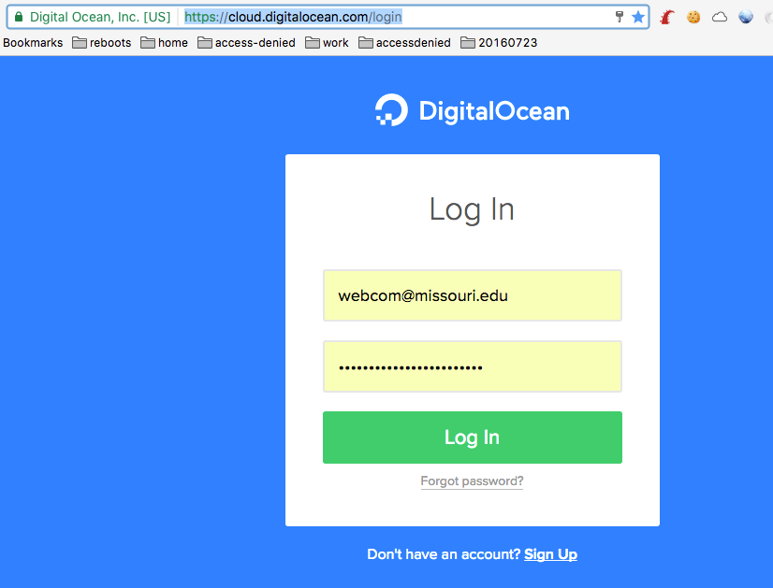
Set Up Our Exercise files
Log into your Digital Ocean account https://cloud.digitalocean.com/login

Slide 4
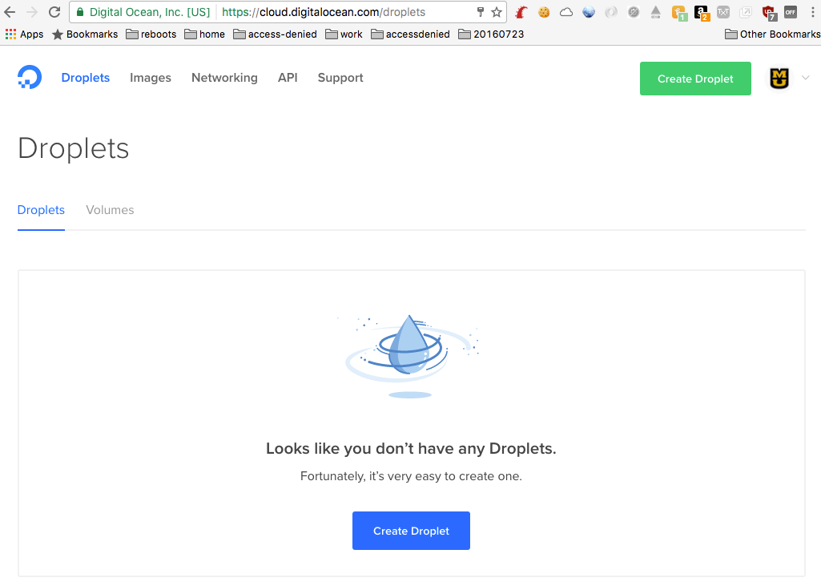
Set Up Our Exercise files
Click on “Create Droplet”

Slide 5
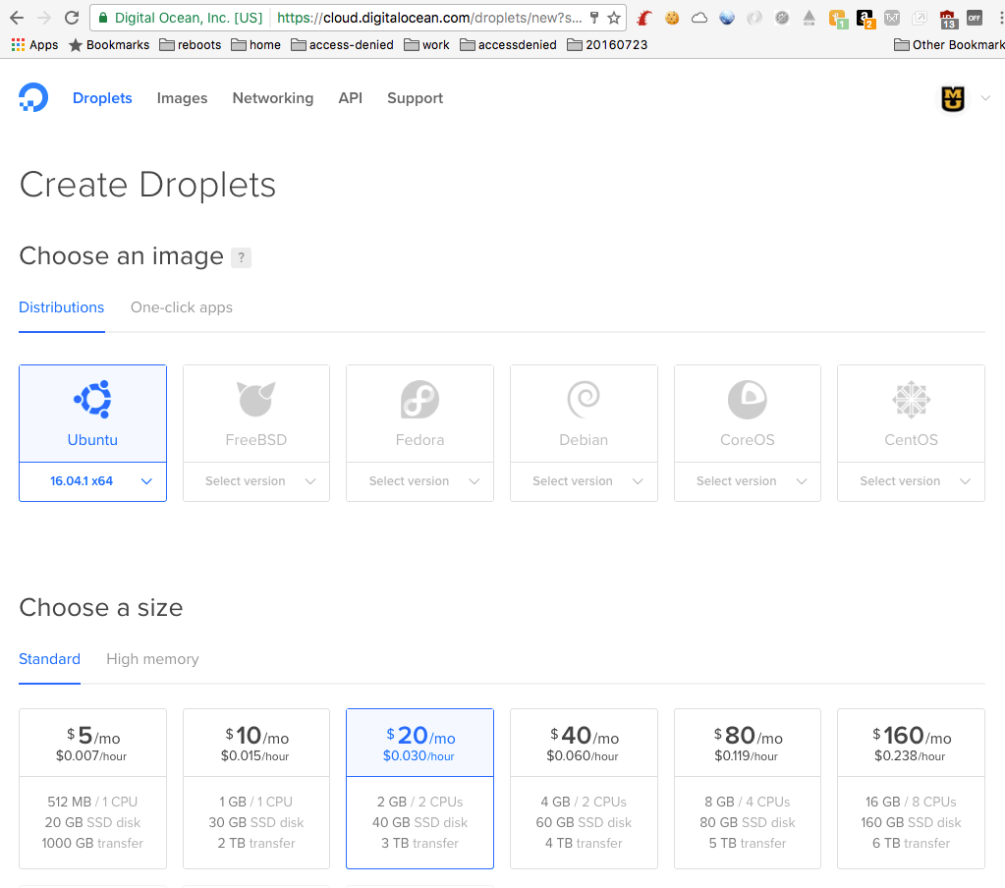
Set Up Our Exercise files
Choose a size
Click on “One-click apps”

Slide 6
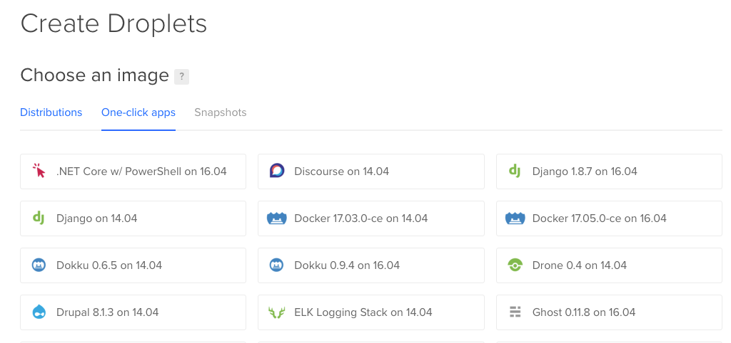
Set Up Our Excersice files
Click on Docker

Slide 7
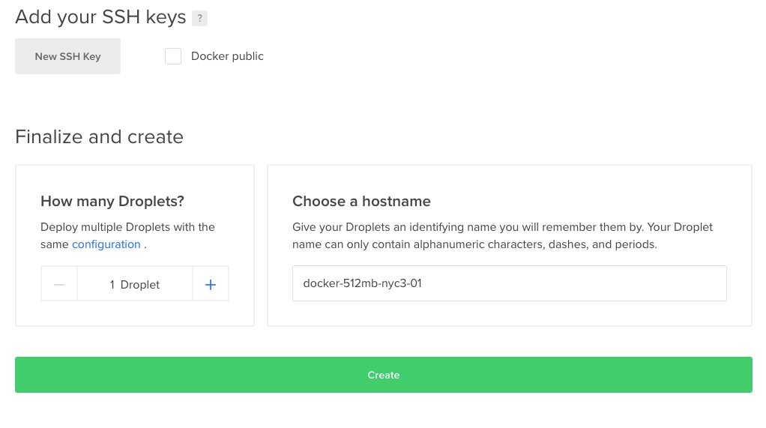
Set Up Our Excersice files
Scroll to the bottom of the page
Click the “Create” button

Slide 8
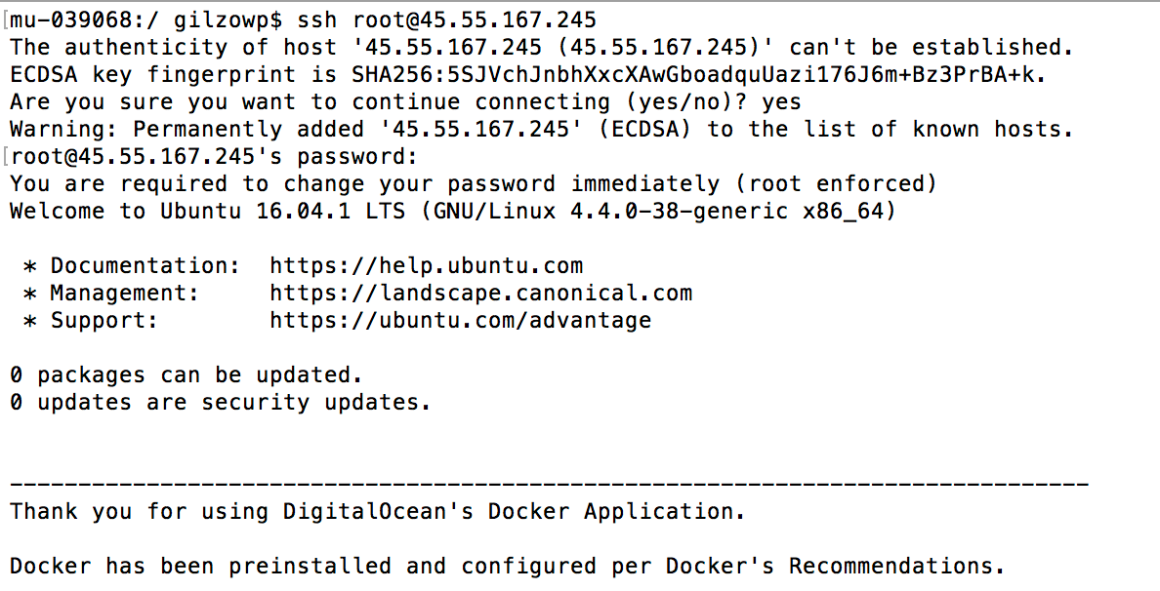
Set Up Our Excersice files
Once the instance is created, check your email for the credentials
In your ssh client, log into your new instance
Notes:
Windows: WinSCP/SecureCRT/Putty
Mac: terminal

Slide 9
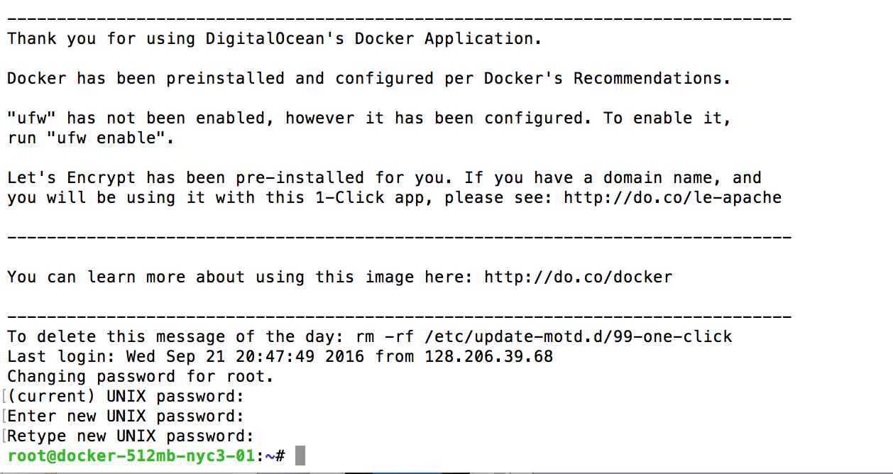
Set Up Our Excersice files
You’ll need to change your password the first time you login

Slide 10
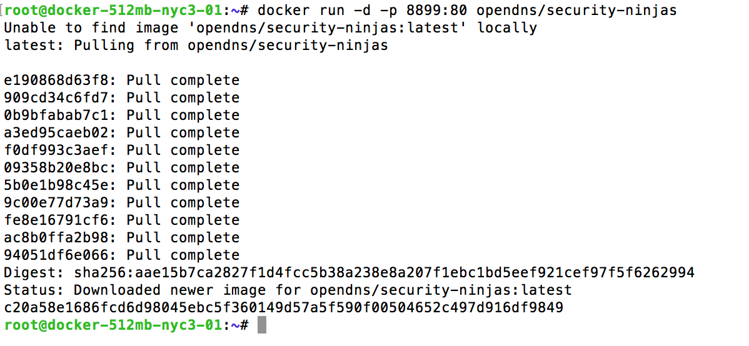
Set Up Our Excersice files
At the prompt type in docker run -d -p 8899:80 opendns/security-ninjas
Docker will download and install the security-ninjas container
Notes:
the 8899 is arbitrary
because you always forget, -d is for detached mode

Slide 11
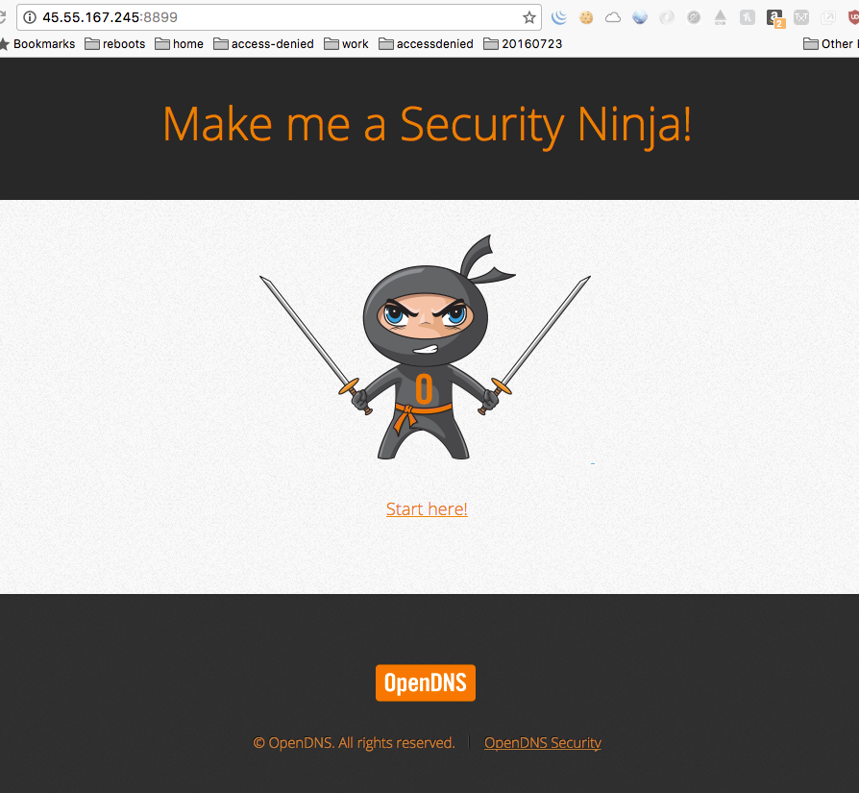
Set Up Our Excersice files
Open your browser and go to your droplet ip address, port 8899 e.g. http://45.55.167.245:8899
Notes:
the 8899 is arbitrary

Slide 12
What is OWASP
Open Web Application Security Project
Worldwide non-project organization focused on improving software security by raising awareness
Started in 2001
Hundreds of local chapters throughout the world, with over a hundred in the U.S.
Notes:
3 chapters in TN

Slide 13
Why is WebAppSec Important
Web Application Security is a combination of
People
Processes
Technology
Security is process, not an event
Secure coding must deal with all stages of an app’s life cycle

Slide 14
Current State of Web App security
Education Industry
Education, 49% of sites had at least one vulnerability every day of the year¹
Education, average of 28 vulnerabilities per site, 15 of those serious¹
Education, took an average of 4 months to remediate issues¹
1 - White Hat Security Web Applications Security Statistics Report 2016
Notes:
2 biggest issues in website/web application security is education and awareness.
As a developer, it is your responsibility to be paranoid

Slide 15
Why are We a target
Domain
Resources
Data

Slide 16
What is the OWASP Top 10
Not a standard, but an awareness document
10 Most Critical Web Application Security Risks
For each risk, it includes
Description
Example vulnerabilities
Example Attacks
Guidance on how to avoid
First released in 2003, refreshed every 3 years
Current version is from 2013, next version (2017) is in Release Candidate status
Notes:
Mention how the Top 10 is developed/formulated
first released in 2003, then in 2004 switched to every 3 years

Slide 17
Current State of Web App security
35% increase in websites hosting malware between 2016 and 2017¹
80% of web apps have at least one vulnerability²
Average of 45 vulnerabilities per application²
25% of web applications vulnerable to 8 of the OWASP Top 10²
1 - Google Transparency Report, 2017
2 -Contrast Security Labs Web Application Vulnerability report 2017
Notes:
Vulnerable JavaScript Libraries (which open up a web app to XSS attacks) - have more than doubled since 2015.
https://www.contrastsecurity.com/security-influencers/25-percent-of-web-apps-still-vulnerable-to-eight-of-the-owasp-top-ten

Slide 18
Current Top 10 (as of 2013)
Injection
Broken Authentication and Session Management
Cross-Site Scripting (XSS)
Insecure Direct Object Reference
Security Misconfiguration
Sensitive Data Exposure
Missing Function Level Access Control
Cross-Site Request Forgery (CSRF)
Using Components with Known Vulnerabilities
Unvalidated Redirects and Forwards

Slide 19
A1. Injection
What is it?
Untrusted/tainted data is sent to an interpreter as part of a command or query.
Interpreter is tricked into executing unintended commands

Slide 20
A1. Injection
What is susceptible?
HTML/Javascript
SQL
LDAP
Xpath/Xquery
Anything that accepts input and executes

Slide 21

A1. Injection

Slide 22
A1. Injection
Why does it happen?
Failure to separate untrusted data with commands sent to an interpreter
Lack of input validation and/or input sanitation
Attacker is able to change execution context

Slide 23
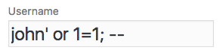
A1. Injection
Examples
SQL Injection SELECT UserId, Name, Password FROM Users WHERE UserId = $input; Becomes SELECT UserId, Name, Password FROM Users WHERE UserId = 105 or 1=1;

Slide 24
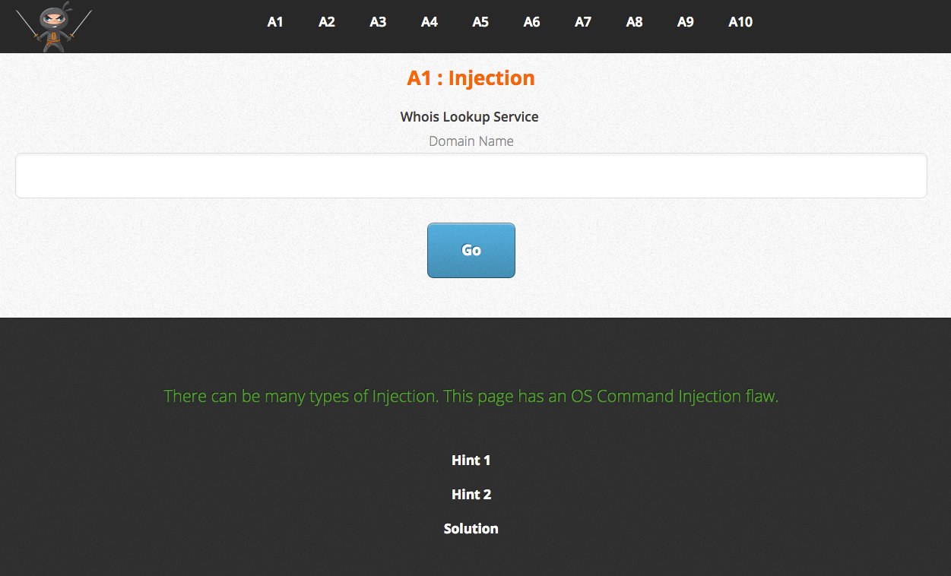
A1. Injection
ATTACK!
Notes:
echo “$(/etc/passwd)”

Slide 25
A1. Injection
Prevention
Use APIs that provide parameterized/sanitized interfaces
Validate input against a whitelist (do NOT use a blacklist)
Escape any special characters that you whitelist
Notes:
regex101.com

Slide 26
A2. Broken Authentication and Session Management
What is it?
Failure to protect credentials and session tokens throughout the lifecycle of the session
Weak authentication logic
Imperfect implementation
Notes:
Should I discuss that the web is stateless and that credentials (Sessions) have to be passed with every request so an app knows who the requester is?

Slide 27
A2. Broken Authentication and Session Management
Why does it happen?
Passing the session ID as a parameter in the URL
Using a predictable value for the session ID
User credentials passed unencrypted
Poor username and password recovery functions

Slide 28
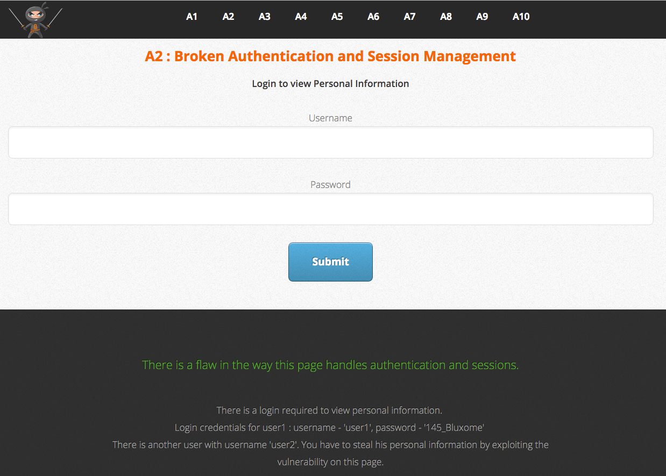
A2. Broken Authentication and Session Management
ATTACK!
Notes:
look at the cookie. what does that value look like?
https://hashes.org/
http://www.sha1-online.com/

Slide 29
A2. Broken Authentication and Session Management
Prevention
Never send credentials/sensitive data in the clear; use SSL
Make sure Secure flag is set on your cookies especially the session cookie
Add Http Strict Transport Security header to your web/app server
Protect secrets throughout their lifecycle
Don’t expose credentials (including session IDs) in the URL or logs
Use centralized authentication and session management APIs, if available
Implement strong account management functions (e.g., account creation, change password, recover password, etc.)
Notes:
This one is huge. How many more should I include? HSTS instructs the browser to ONLY communicate with that domain via https
SSOID, BearPass at MSU?

Slide 30
A2. Broken Authentication and Session Management
Prevention
Use strong algorithms to generate (random) secrets
Do not rely on untrustworthy information for authentication (e.g. IP address, referrer, etc.)
Use a different session ID after authentication or whenever authorization/permission levels change
Destroy/invalidate the session ID completely after the log out method has completed
Enforce session timeouts
Protect against Cross-Site Scripting (XSS)

Slide 31
A3. Cross-Site Scripting (XSS)
What is it?
Similar to injection, but the intended target is a user’s browser: the user’s browser is tricked into executing unintended commands
Usually in the form of HTML code or client-side scripts
Occurs when an application (client or server-side) takes unstrusted data from the user and uses it without validation or encoding
Exploits the trust the user has for a site
Notes:
dont forget to mention same origin policy

Slide 32

If an attacker controls your browser, it is no longer your browser

Slide 33
A3. Cross-Site Scripting
Why does it happen?
Failure to separate untrusted data with commands
Lack of input validation and/or input sanitation
Attacker is able to change execution context

Slide 34
A3. Cross-Site Scripting
Types
Reflected
Stored (aka persistent)
Dom based
Notes:
Mention Self-XSS, especially when combined with Clickjacking, to form XSSJacking https://github.com/dxa4481/XSSJacking

Slide 35
A3. Cross-Site Scripting
Types: Reflected
Data from the URL is used in the creation of the page
Attacker tricks/entices user to click the exploited URL
Web application reflects the payload back to the user’s browser where it is executed as if it came from the originating site

Slide 36
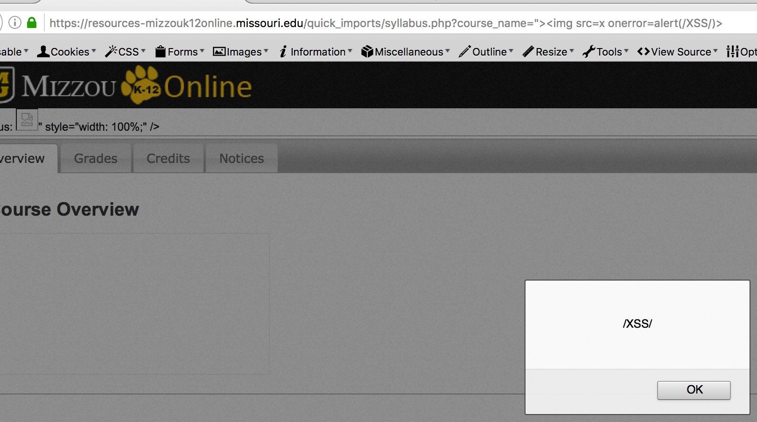
A3. Cross-Site Scripting
Types: Reflected Example

Slide 37
A3. Cross-Site Scripting
Types: Stored/Persistent
Injected script is stored on the target server
The injection script is then sent to visitors of the site
Vicitim’s browser then executes the injected script as it believes it came from the originating site
Delayed (aka “Blind”) refers to the payload being executed at a later time, possibly in a completely different system (e.g. Log viewers, customer service apps, etc.)

Slide 38
A3. Cross-Site Scripting
Types: Stored Example
Notes:
Do we need a stored example?

Slide 39
A3. Cross-Site Scripting
Types: Dom-based (aka Client Side)
Similar to reflected but instead of tricking the user’s browser to exectute script, tricks legitimate client side script into executing the payload
The attack payload is executed as a result of modifying the DOM environment in the victim’s browser used by the original client side script, so that the client side code runs in an unexpected manner
More prevalent now than in the past due to the increase use in javascript and vulnerable javascript libraries (almost 200% increase between 2015 and 2016¹)
1 - Acunetix web application vulnerability report 2016, pg 5
Notes:
acunetix web application vulnerability report 2016, pg 5

Slide 40
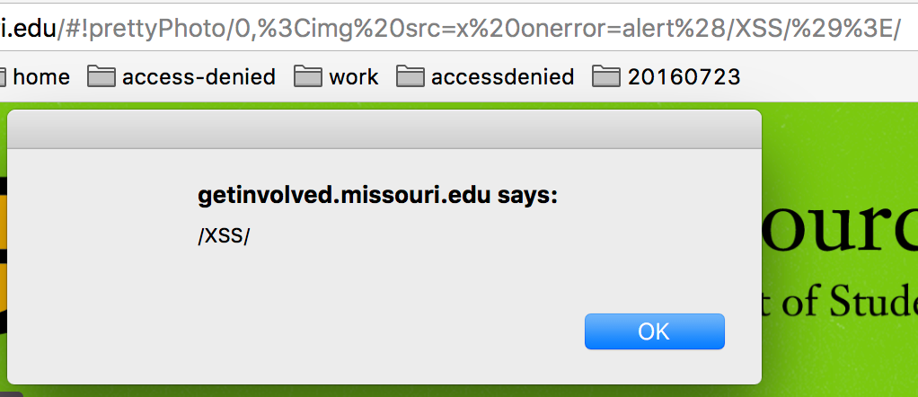
A3. Cross-Site Scripting
Types: Dom-based Example

Slide 41
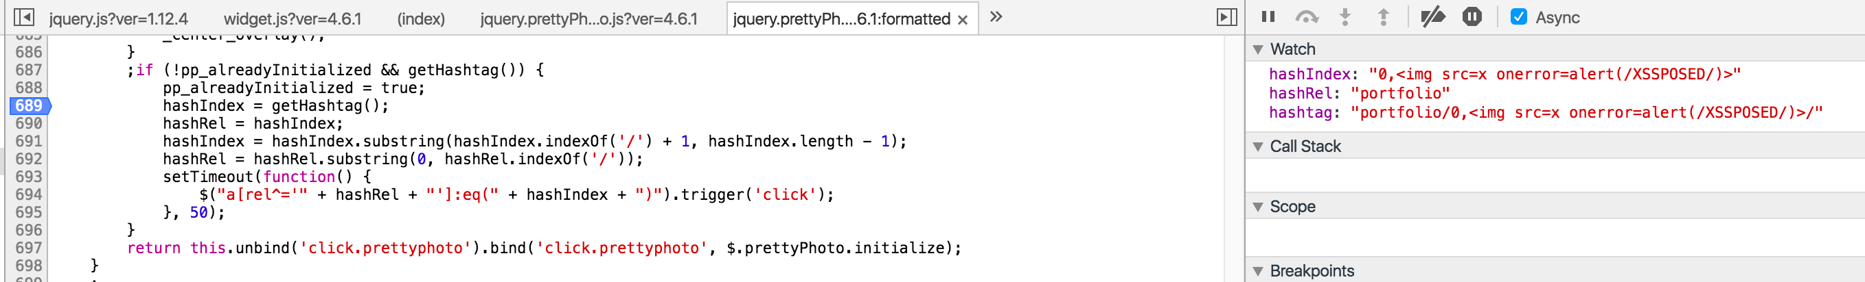
A3. Cross-Site Scripting
Types: Dom-based Example, cont.

Slide 42
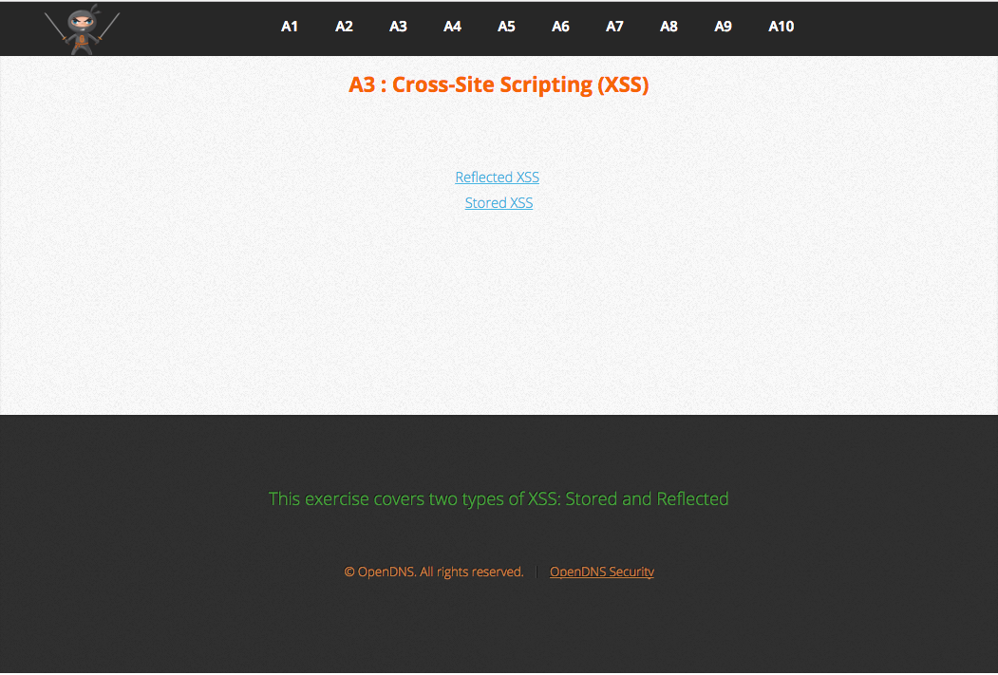
A3. Cross-Site Scripting
ATTACK!

Slide 43
A3. Cross-Site Scripting
Prevention
Implicitly deny
Validate all input, regardless of where it comes from (inbound handling)
Context-based output encoding (outbound handling)

Slide 44
A3. Cross-Site Scripting
Prevention - Context-based output encoding
HTML Element Content <div>DATA</div>
HTML Attribute Values <input name=“DATA” type=“text” value=“DATA” />
Javascript Data <script>someFunc(‘DATA’);</script>
CSS Property Values .foo a:hover{ color: DATA }
URI Attribute VAlues <a href=“/search/?q=DATA”>
( &, <, >, “) —> &entity; ( ‘, / ) —> &#DDD; or &#xHH; (UTF-8 encode)
All non-alphanumeric —> &#xHH;
All non-alphanumeric —> \xHH
All non-alphanumeric —> \HH
All non-alphanumeric —> %HH
Notes:
UTF-8 encoding https://mothereff.in/utf-8

Slide 45
A3. Cross-Site Scripting
Prevention
Implicitly deny
Validate all input, regardless of where it comes from
Context-based output encoding
Content-Security-Policy headers

Slide 46
A3. Cross-Site Scripting
Prevention - Content-Security-Policy headers
Set of HTTP Response headers (or can be implemented via meta element) that defines where resources can be loaded from, preventing users’ browser from loading data from any other locations. Header Set Content-Security-Policy: script-src 'self' https://apis.google.com <meta http-equiv="Content-Security-Policy" content="default-src 'self'">
Notes:
https://content-security-policy.com/

Slide 47
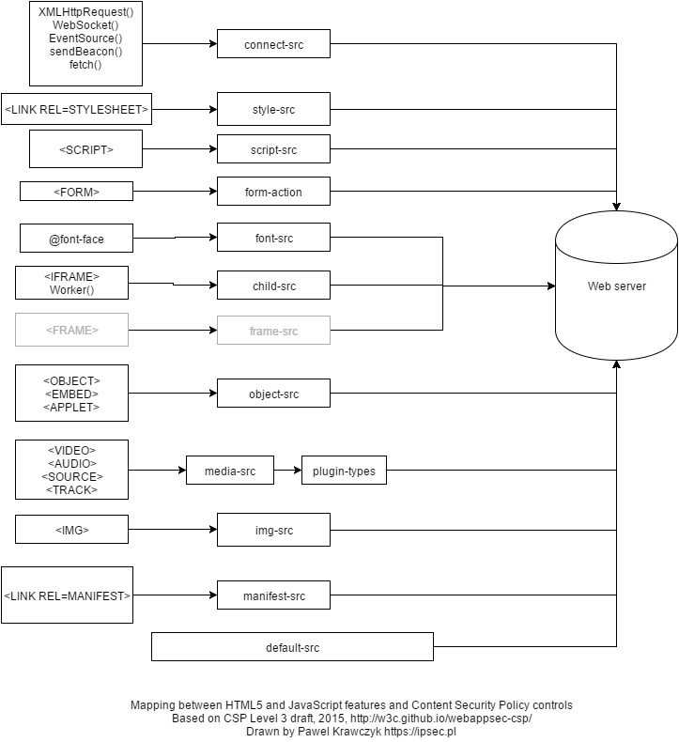
A3. Cross-Site Scripting
Prevention - Content-Security-Policy headers

Slide 48
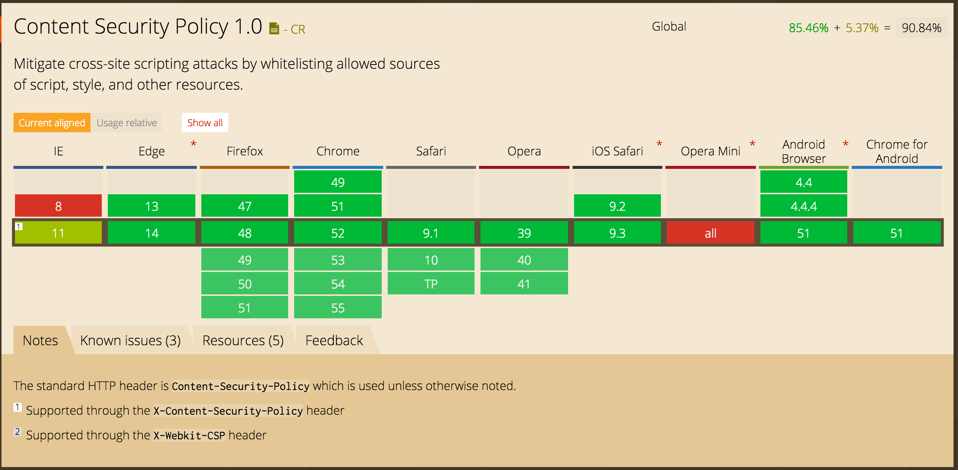
A3. Cross-Site Scripting
Prevention - Content-Security-Policy headers
http://caniuse.com/#feat=contentsecuritypolicy

Slide 49
A4. Insecure Direct Object References
What is it?
Occurs when a reference to an internal implementation object (file, directory, database record/key) is exposed as a URL or form parameter
Without subsequent authorization checks, an attacker can manipulate these parameters to access unauthorized data

Slide 50
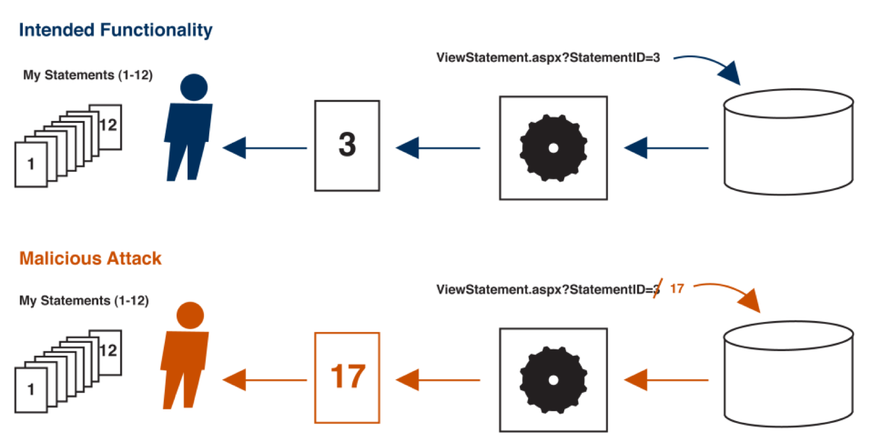
A4. Insecure Direct Object References
Examples
Notes:
This example also exemplifies A7: Missing Function level Access Control

Slide 51
A4. Insecure Direct Object References
Examples
http://foo.bar.edu/file.php?file=report.txt
http://foo.bar.edu/file.php?file=../../app/config/database
Notes:
From the example files, they include this as a server misconfiguration, not direct object reference. leave, move or remove?

Slide 52
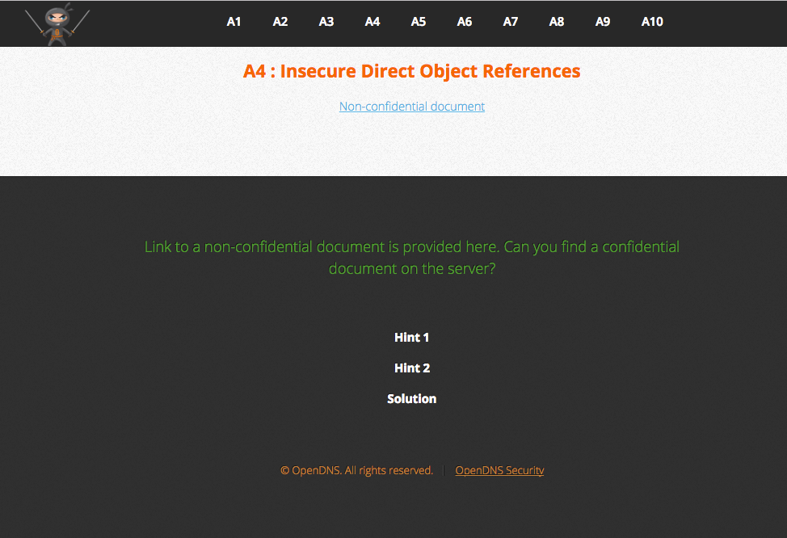
A4. Insecure Direct Object References
ATTACK!
Notes:
in terminal
echo hexvalue | xxd -r -p
xxd -p <<< “string to convert”
dont forget : 0a is new line

Slide 53
A4. Insecure Direct Object References
Prevention
Do not expose internal keys or identifiers for objects
Use object references that are difficult to guess
Perform server-side authorization checks for object access

Slide 54
A5. Security Misconfiguration
What is it?
Security issues anywhere in the stack
Framework
Application Server
Web Server
Database Server
Operating System
3rd party contols/modules

Slide 55
A5. Security Misconfiguration
Examples
Application dumps stack trace or reveals other debugging information
Default passwords not changed
Out-of-date software
Directory listings enabled

Slide 56
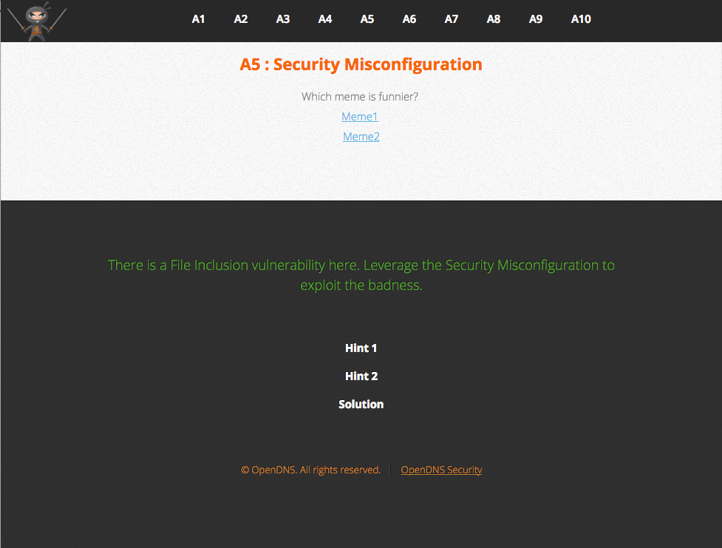
A5. Security Misconfiguration
ATTACK!

Slide 57
A5. Security Misconfiguration
Prevention
Security hardening throughout the entire application stack
Change default passwords
Disable/remove debugging message and overly informative error messages in production
Remove unnecessary/unused features/modules/components
Notes:
periodic audits/scans
Stay on top of framework/library/component updates

Slide 58
It can’t be exploited if it isn’t there

Slide 59
A6. Sensitive Data Exposure
What is it?
Storing and transmitting sensitive data insecurely, due to:
Failure to identify all sensitive data
Failure to identify all locations where sensitive data is stored (database, files, logs, backups, etc)
Failure to identify all locations sensitive data is sent (web, databases, internal communications, external business partners)
Notes:
failure to protect the data in transit and at rest

Slide 60
A6. Sensitive Data Exposure
Examples
Debugging information in comments of ouput sent to the browser
Application that stores sensitive data (correctly) encoutners an error and logs that data insecurely
Notes:
failure to protect the data in transit and at rest

Slide 61
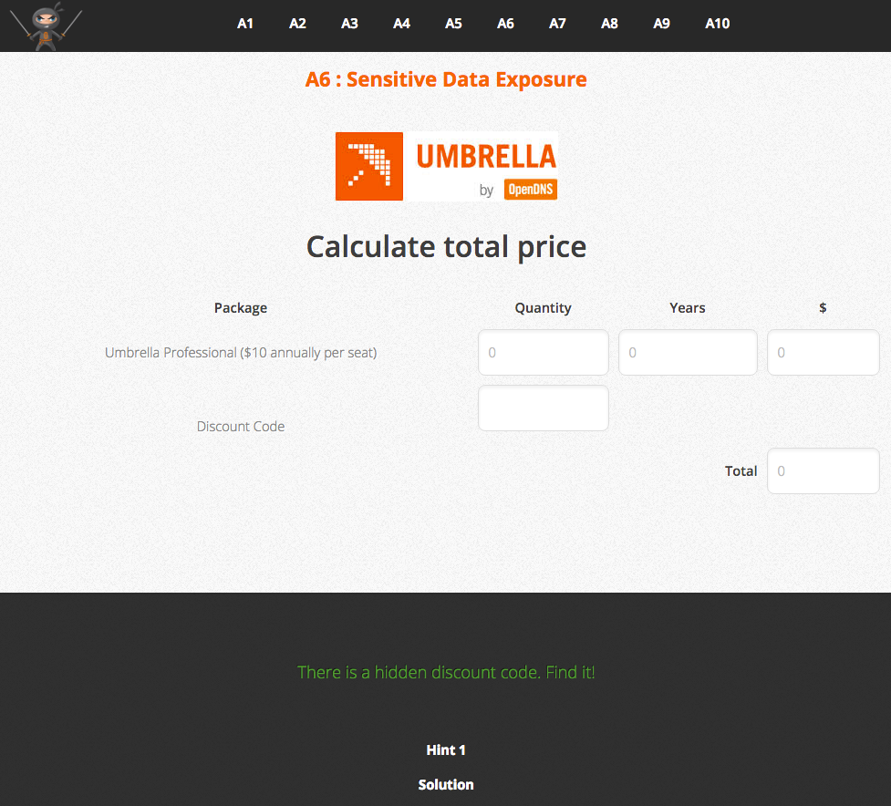
A6. Sensitive Data Exposure
ATTACK!

Slide 62
A6. Sensitive Data Exposure
Prevention
Notes:
Someone can’t steal it from you if you don’t have it

Slide 63
Someone can’t steal it if you don’t have it

Slide 64
A6. Sensitive Data Exposure
Prevention
Don’t store sensitive data if you don’t need it
Catalog all sensitive data and where it is used
Disable caching of pages that contains sensitive data
Encrypt all sensitive data at rest and in transit
Use strong standard algorithms and strong keys
Notes:
Someone can’t steal it from you if you don’t have it

Slide 65

A7. Missing Function Level Access Controls
What is it?
Enforcing proper authorization for requests
Notes:
failure to protect the data in transit and at rest

Slide 66
A7. Missing Function Level Access Controls
Examples
Notes:
Remember back to A4?

Slide 67
A7. Missing Function Level Access Controls
Examples
Attacker notices the URL structure indicates his role https://example.com/user/getAccount
Attacker modifies it to another role https://example.com/admin/getAccount
The application fails to do a server-side check to verify the request is coming from a user with the proper authorization and the attacker now has access to data on any account
Notes:
failure to protect the data in transit and at rest

Slide 68
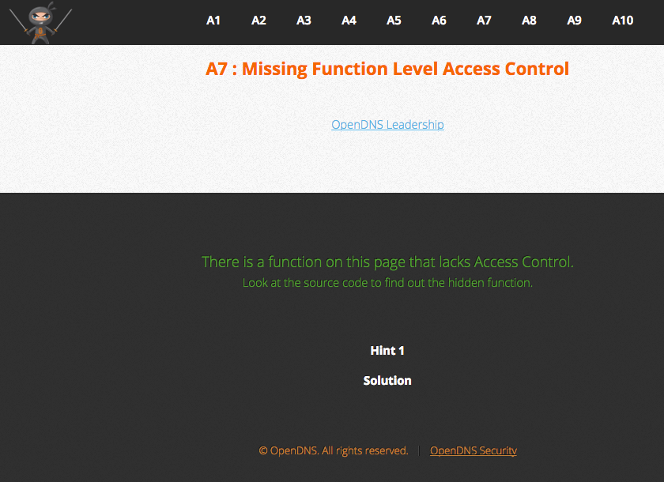
A7. Missing Function Level Access Controls
ATTACK!
Notes:
failure to protect the data in transit and at rest

Slide 69
A7. Missing Function Level Access Controls
Prevention
Deny by default
Perform server-side checks for every function/action that requires authorization
Server-side checks should not rely soley on information provided by the client
Notes:
failure to protect the data in transit and at rest

Slide 70
A8. Cross-Site Request Forgery
What is it?
Victim’s browser is tricked into issuing commands to a vulnerable web application, to perform an unwanted action on a trusted site for which the user is currently authenticated.
Web browsers automatically include credentials (cookies, sessions, basic authentication headers) with each request, even for requests initiated by a form, script or image on another site
Server-side code processes requests as if they came from the authenticated user
Often combined with Cross-Site Scripting

Slide 71
A8. Cross-Site Request Forgery
Examples
Application is built to allow a state change via URL parameters http://bankx.com/app?action=transfer&amount=3500&destinationAccount=4673243243
Attacker constructs a request that will transfer funds to to their account and embeds the requests on sites he controls. He then tricks the victim into visiting the site
<img src="http://bankx.com/app?action=transfer&amount=14000&destinationAccount=attackersAcct#" width="0" height="0" />

Slide 72
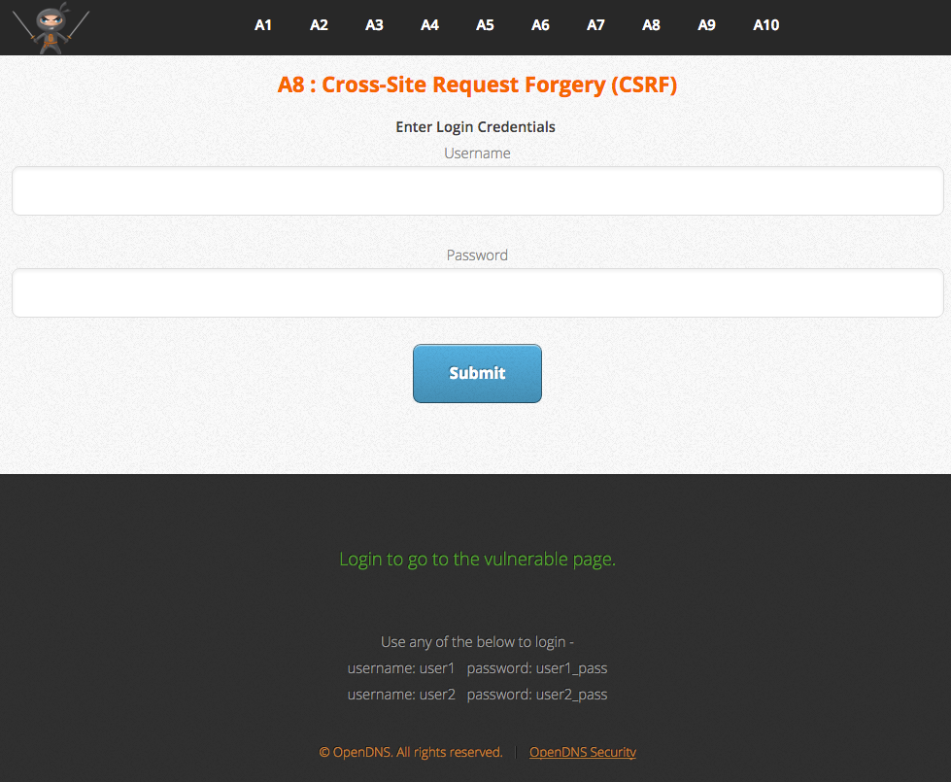
A8. Cross-Site Request Forgery
ATTACK!

Slide 73
A8. Cross-Site Request Forgery
Prevention
Eliminate all XSS vulnerabilities in your application
Never allow changes to data via a GET request
Check Origin and Referer headers as a first step
Include a per-request, cryptographically strong or random token to all forms, where the verification token is not provided by the browser
Require reauthentication for sensitive transactions
Notes:
XSS can be used to scrape the token from the page and include that token with a forged request.

Slide 74
A9. Using Components with Known Vulnerabilities
What is it?
Using third-party controls/modules/frameworks with known vulnerabilities anywhere in the stack can be discovered and exploited by automated tools
Third-party libraries/frameworks in an application typically run with the same privileges as the application
Those vulnerabilities can undermine other defenses

Slide 75
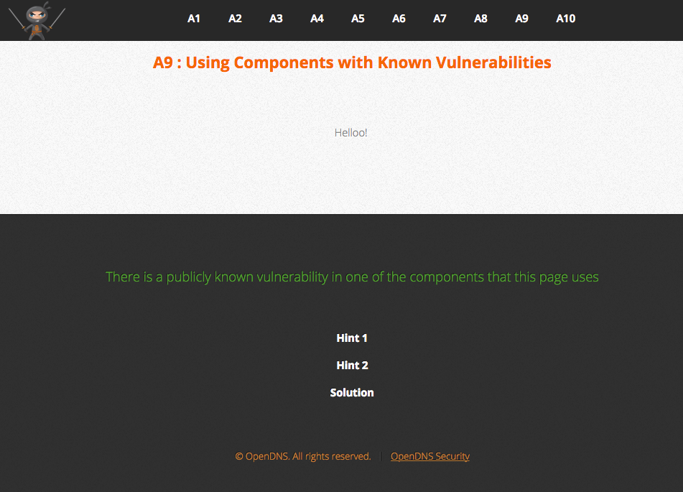
A9. Using Components with Known Vulnerabilities
ATTACK!
Notes:
]

Slide 76
A9. Using Components with Known Vulnerabilities
Prevention
Identify all third-party components in your applications, and potentially throughout the entire stack
Uninstall/disable all third-party components that are not being used
Monitor the security of these components in public databases (CVE, NVD, etc.), security mailing lists
Keep third-party components up-to-date religiously
Develop a security policy on third-party component use
Notes:
How and when 3rd party code is ok to use, does it need to follow certain standards, pass security tests, etc?

Slide 77
A10. Unvalidated Redirects and Forwards
What is it?
Application takes input from an external source that is then used to formulate a redirection or forward location without validation
Attacker links to an unvalidated redirect and tricks victims into clicking it. Victims are more likely to click on it, since the link is to a valid site https://www.irs.gov/taxrefund/claim.jsp?year=2015&dest=ev.il/sDfX4

Slide 78
A10. Unvalidated Redirects and Forwards
What is it?
Application uses forwards to route requests between different parts of the site. Pages use a parameter to indicate where the user should be sent if a transaction is successful.
Attacker crafts a URL that will pass the application’s access control check (or is missing control checks) and then forwards the attacker to administrative functionality for which the attacker isn’t authorized.
Notes:
Ties back to A7

Slide 79
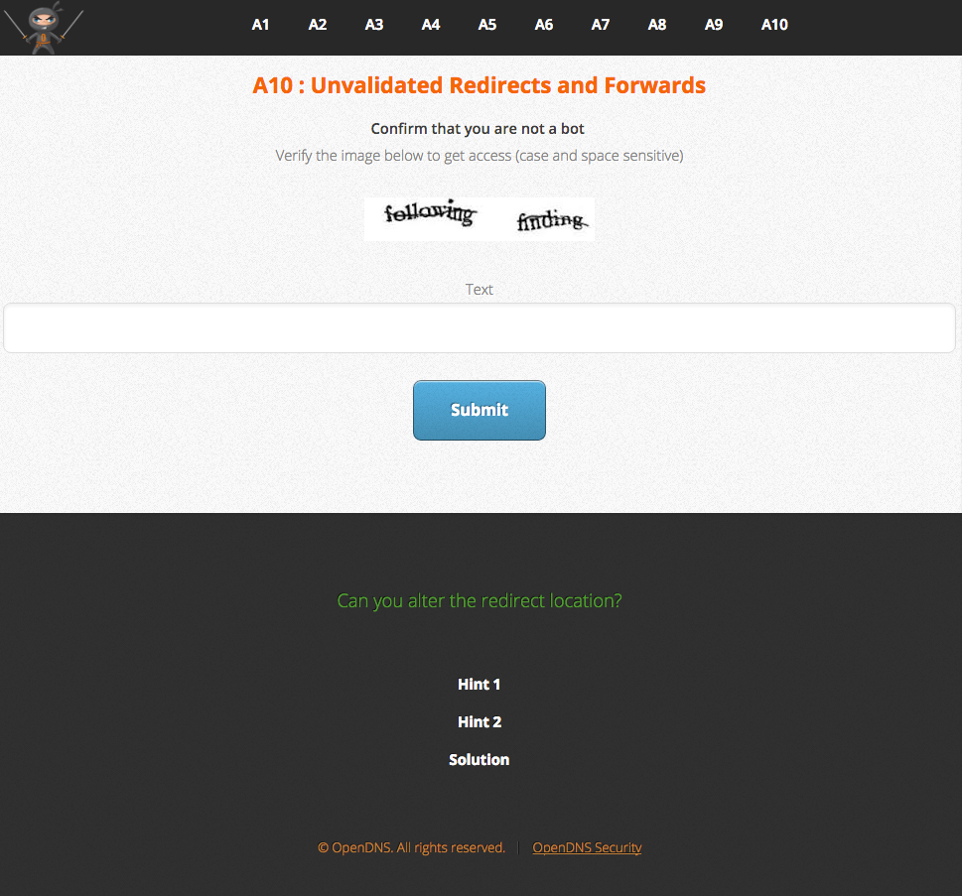
A10. Unvalidated Redirects and Forwards
ATTACK!
Notes:
failure to protect the data in transit and at rest

Slide 80
A10. Unvalidated Redirects and Forwards
Prevention
Don’t use them unless you absolutely have to
Avoid using user input to detemine destination URL
Whitelist allowed pages or external sites
Ensure URL is valid and authorized for the user

Slide 81
Developer Take-aways
Notes:
failure to protect the data in transit and at rest

Slide 82
Security is a process, not an event.
Notes:
what we cover/discuss today might not be relevant next year

Slide 83
Developer Take-aways
Security is a process, not an event
Build security into the software development life-cycle
Notes:
failure to protect the data in transit and at rest

Slide 84
Be paranoid; be skeptical
Notes:
what we cover/discuss today might not be relevant next year

Slide 85
Developer Take-aways
Security is a process, not an event
Build security into the software development life-cycle
Be paranoid; be skeptical
Treat all data as tainted
Validate data first (whitelist), then filter (blacklist)
Validate/clean as early in the process as possible
Encode data appropriately before sending to the client
Never rely on client-side checks

Slide 86
Developer Take-aways
Continued
Defense-in-depth
Principle of Least Privilege
Limit access to everything
Enforce strong passwords
Don’t harcode secrets in source code
Keep third-party components up-to-date
Remove overly informative error message and debug information from production
Notes:
failure to protect the data in transit and at rest

Slide 87
OWASP 2017 RC Changes
2013-A4 Insecure Direct Object References and 2013-A7 Missing Function Level Access Control were combined into 2017-A4 Broken Access Control
Removed 2013-A10 Unvalidated Redirects and Forwards
Two new “risks” have been introduced
Insufficient Attack Detection and Prevention
Underprotected APIs

Slide 88
OWASP 2017 Release Candidate
Injection
Broken Authentication and Session Management
Cross-Site Scripting (XSS)
Broken Access Controls
Security Misconfiguration
Sensitive Data Exposure
Insufficient Attack Protection
Cross-Site Request Forgery (CSRF)
Using Components with Known Vulnerabilities
Underprotected APIs

Slide 89
Questions?
Contact
gilzow@missouri.edu
@gilzow on twitter
Example Files: https://github.com/opendns/Security_Ninjas_AppSec_Training
Slidedeck: https://github.com/gilzow/security-ninja/

